Slide 1
hola!

Slide 2
Illustrator / Photoshop ?

Slide 3
Vector vs Bitmap

Slide 4
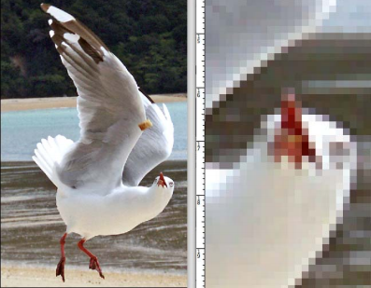
Vector vs Bitmap

Slide 5
Resolution (dpi)
72dpi
150dpi
200dpi
300dpi
Web
Big formats
Standard Printing
Professional Printing

Slide 6
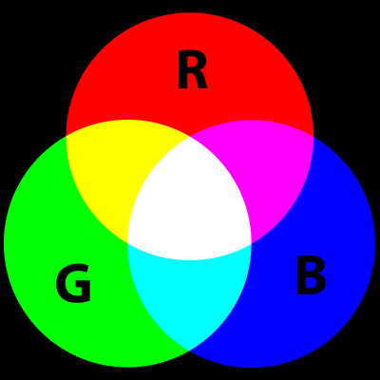
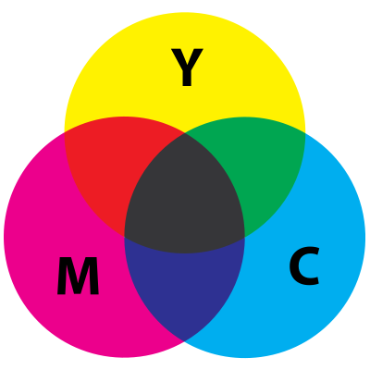
RGB vs CMYK

Slide 7
